Slide 1
Project Report 6
0111279 Annie Chen

Slide 2
目前的進度
釐清論文(Performance-Aware-Thermal-Management-via-Task-Scheduling)內容
以simulation的方式驗證論文所提出的policy是否在多核心的環境下，一樣能成功控管各核心溫度平衡(以psensor監控核心溫度變化)
用powertop監控核心耗能的情況

Slide 3
Performance-Aware-Thermal-Management-via-Task-Scheduling
為甚麼使用thermal model取得溫度，而不直接從sensor讀值就好？
DTS readings are insufficient for two reasons as below,
ThreshHot scheduler need both current temperature and temperature in the next time interval.
It is difficult to decide the future temperature of a job based on its temperature history if it is not executed now.

Slide 4
Performance-Aware-Thermal-Management-via-Task-Scheduling
Scheduler要如何判斷hot job及cold job？
對thermal model做calibration後，讓他跑22個benchmarks；Benchmarks分為如下兩類：
SPEC CPU2K benchmarks (SPEC)
mediabench, netbench, packetbench (non-SPEC)

Slide 5
Performance-Aware-Thermal-Management-via-Task-Scheduling
要如何將scheduler整合到Linux kernel？
每個job的time quantum在執行時約1~10ms會被interrupt，此時interrupt handler可能會做context switch。
“We choose to insert our scheduling in this interrupt handler to force a context switch on every thermal scheduling interval.”
原本一個job做完完整的time quantum(ex: 100ms)才要context switch，現在變成每個一thermal scheduling interval(ex: 8ms)就要context switch。

Slide 6
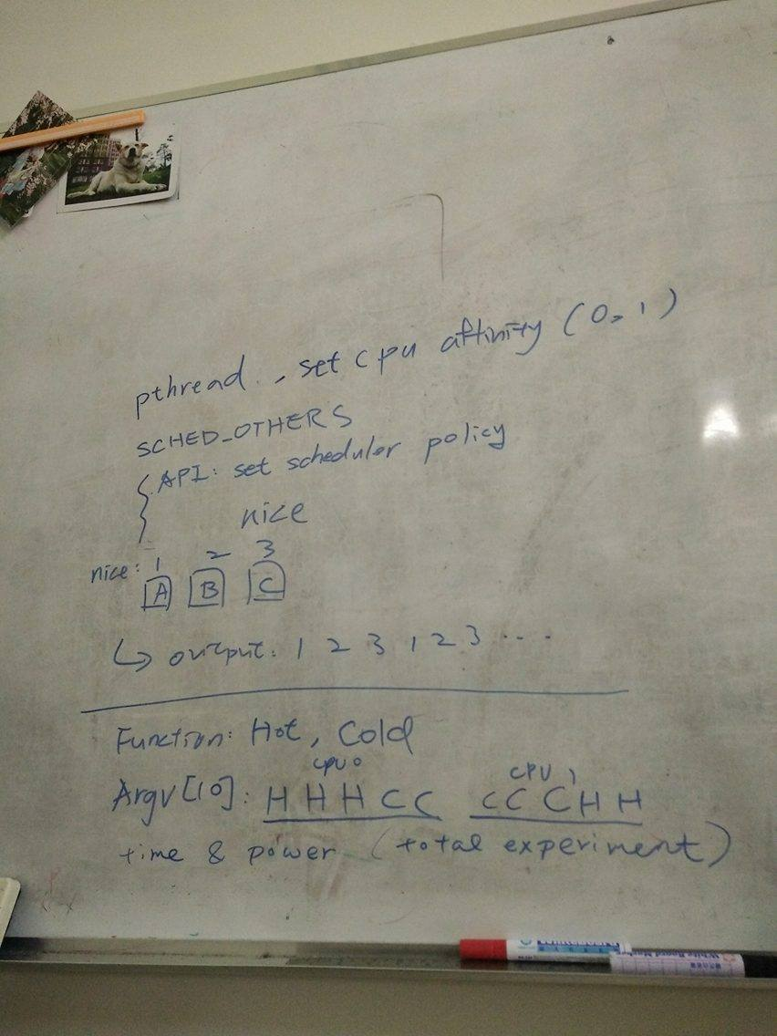
Simulation

Slide 7
Simulation – policy與priority設定
分為SCHED_RR, SCHED_FIFO, SCHED_OTHER
thread function內：
struct sched_param param1;
pthread_attr_t attr1;
pthread_attr_init(&attr1);
pthread_attr_setinheritsched(&attr1,PTHREAD_EXPLICIT_SCHED)//要使優先順序其作用必須要有這句話
pthread_attr_setschedpolicy(&attr1,SCHED_RR);
param1.sched_priority = 21;
pthread_attr_setschedparam(&attr1,&param1);

Slide 8
Simulation – NICE設定
param1.sched_priority只能設定SCHED_RR及SCED_FIFO情況下的priority
在SCHED_OTHER的情況下，須設定thread的nice值以改變其priority
thread function內：
pid_t tid = syscall(SYS_gettid);
setpriority(PRIO_PROCESS, tid, -10);
printf("tid of medium priority thread %d , %d \n",tid , getpriority(PRIO_PROCESS,tid));
main function內：
pid_t pid = getpid();
pid_t tid = syscall(SYS_gettid);
printf("main thread : pid = %d , tid = %d \n" , pid, tid);

Slide 9
Simulation – NICE設定
nice值的範圍為 -20 ~ 19，數字越小，則其priority越高，反之。
實驗二：三個thread分別使用不同的三個thread function
thread function 1：SCHED_OTHER, nice = -10
thread function 2：SCHED_OTHER, nice = 0
thread function 3：SCHED_OTHER, nice = 10
-> Priority：1 > 2 > 3

Slide 10

Simulation – policy與priority設定
param1.sched_priority 的數字越小，priority越高，反之。
實驗一：三個thread分別使用不同的三個thread function
thread function 1：SCHED_RR, param1.sched_priority=21;
thread function 2：SCHED_RR, param1.sched_priority=51;
thread function 3：SCHED_OTHER
-> Priority：1 > 2 > 3

Slide 11
Simulation – Affinity設定
將thread綁定到某一個cpu上執行
thread function內：
cpu_set_t cpuset, cpuget;
Int cpu = 0; //the CPU we want to use
CPU_ZERO(&cpuset); //clears the cpuset
CPU_SET( cpu , &cpuset); //set CPU 0 on cpuset
if (pthread_setaffinity_np(pthread_self(), sizeof(cpuset), &cpuset) < 0) { fprintf(stderr, "set thread affinity failed\n"); }

Slide 12
Simulation – Affinity設定
CPU_ZERO(&cpuget);
if (pthread_getaffinity_np(pthread_self(), sizeof(cpuget), &cpuget) < 0) { fprintf(stderr, "get thread affinity failed\n"); }
if (CPU_ISSET(cpu, &cpuget)) { printf("thread 1 is running in processor %d\n", cpu); }

Slide 13
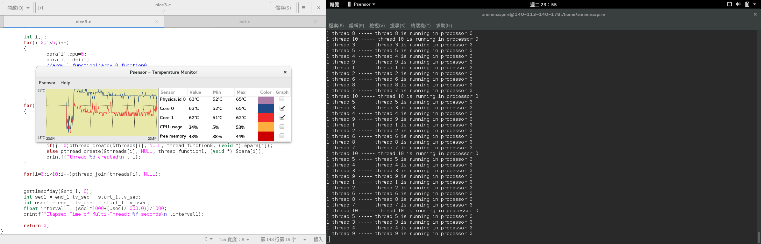
Simulation – Affinity設定

Slide 14
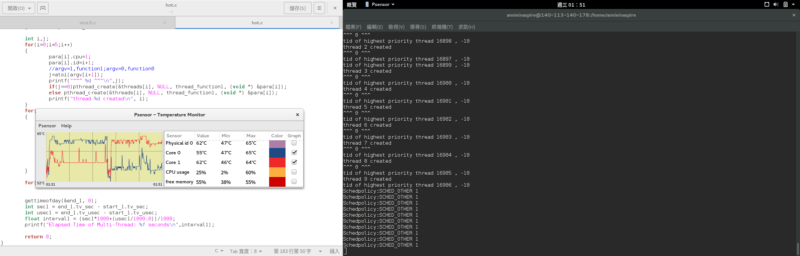
Simulation – Affinity設定

Slide 15
Simulation - integration
合併”nice值設定”和”affinity設定” (實驗三)
從argv(10個)指定要使用哪一個thread function(0 or 1)
使前五個thread綁定到cpu0, 後五個thread綁定到cpu1
thread_function0 -> cold job(memory access)
thread_function1 -> hot job(computation intensive)
For example:
# ./integration 1 1 1 0 0 0 0 0 1 1

Slide 16
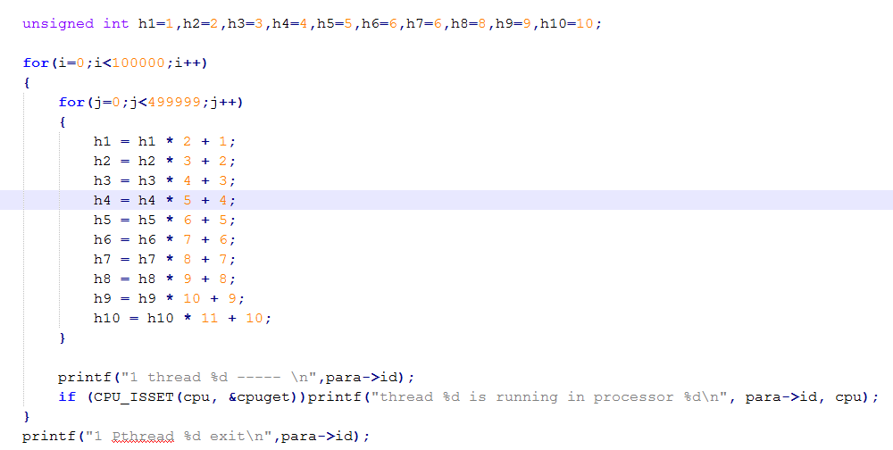
Integration - HOT job

Slide 17
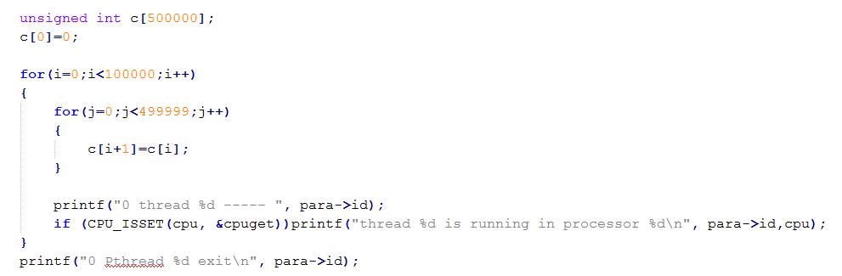
Integration - HOT job VS. COLD job

Slide 18
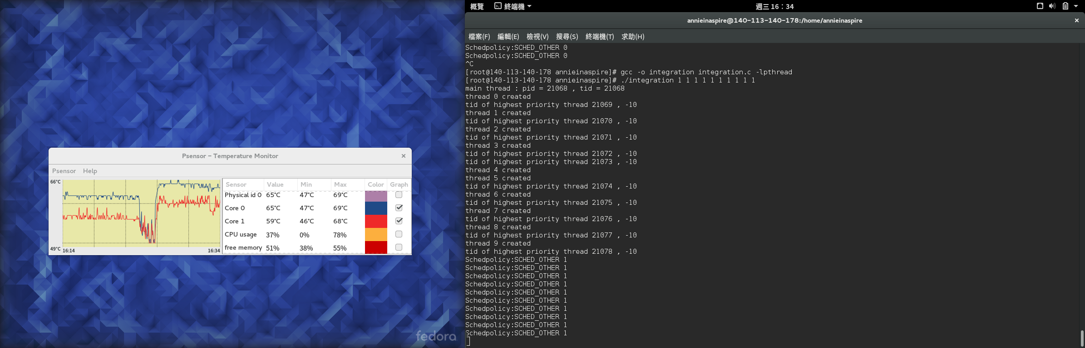
Integration - HOT job VS. COLD job

Slide 19
Integration – 不同job組合及順序
1 1 1 1 1 0 0 0 0 0
1 1 0 0 0 0 0 1 1 1
1 1 1 0 0 1 1 0 0 0
1 1 1 0 0 0 0 0 1 1

Slide 20
Integration – 不同job組合及順序
1 1 1 1 1 0 0 0 0 0 (a)
1 1 1 1 0 1 0 0 0 0
1 1 1 0 0 1 1 0 0 0 (c) = 1 1 1 0 0 0 0 0 1 1 (d)
1 1 0 0 0 1 1 1 0 0 = 1 1 0 0 0 0 0 1 1 1 (b)
1 0 0 0 0 1 1 1 1 0
0 0 0 0 0 1 1 1 1 1

Slide 21
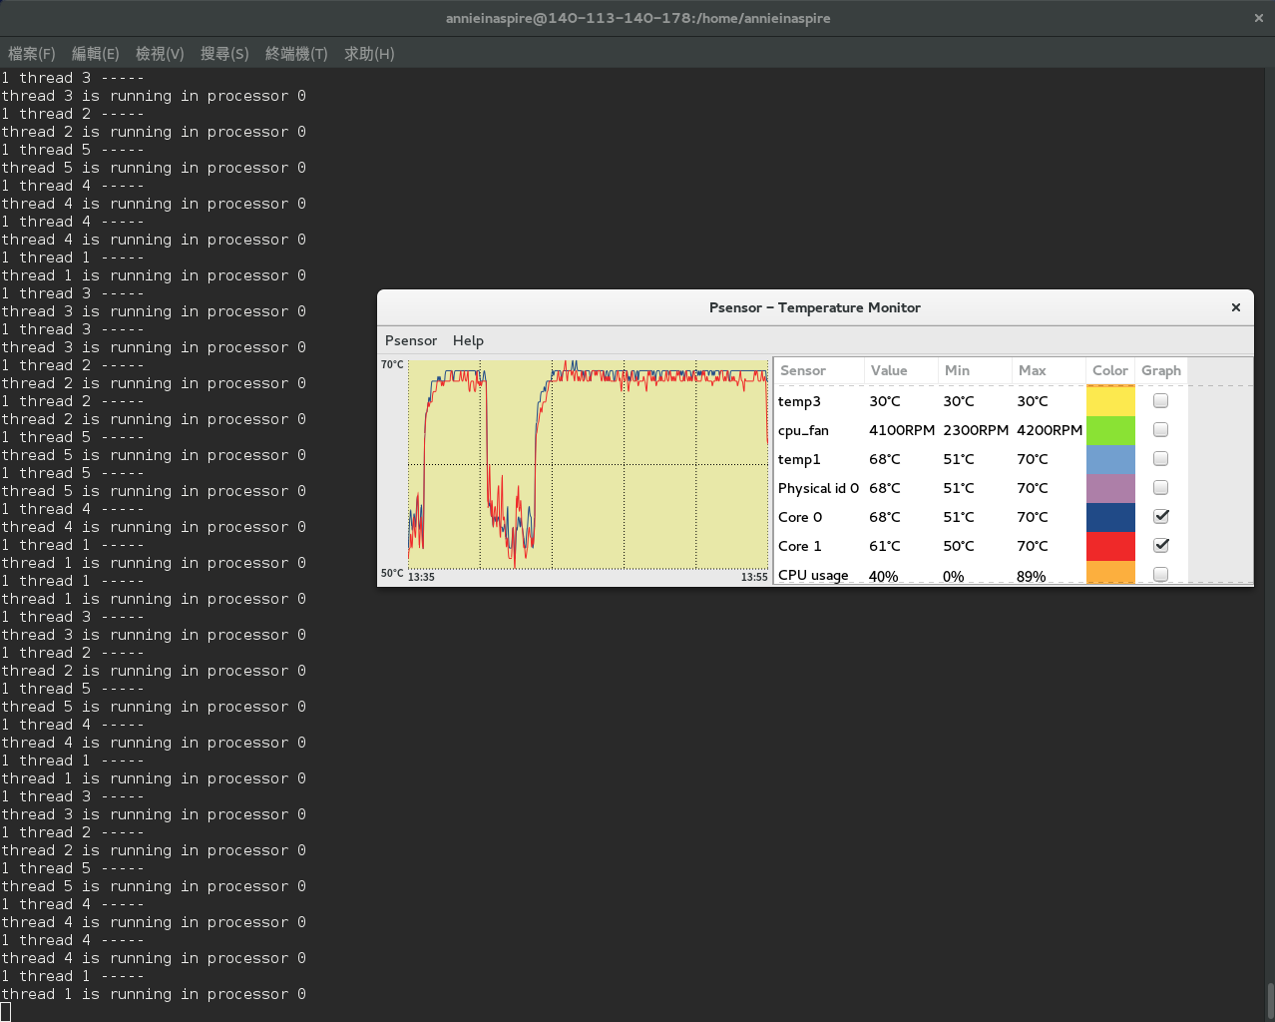
Integration – 1 1 1 1 1 0 0 0 0 0

Slide 22
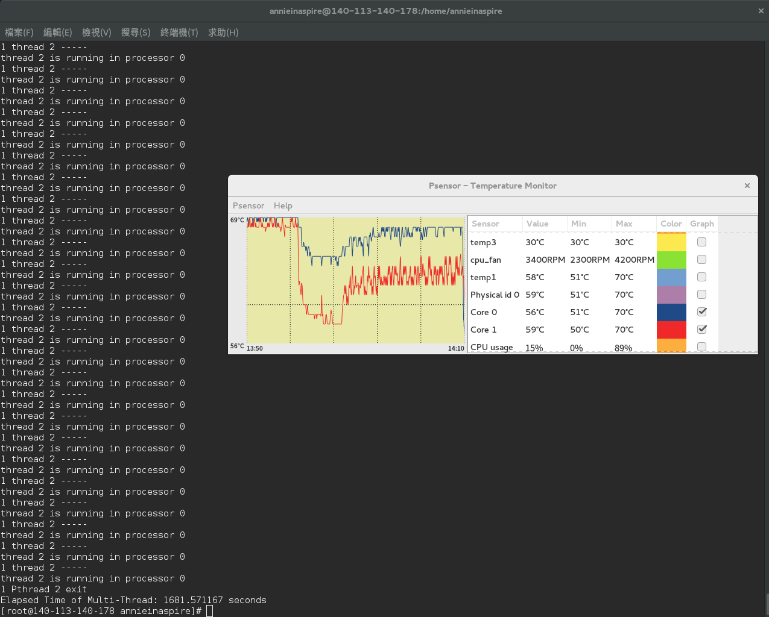
Integration – 1 1 1 1 1 0 0 0 0 0

Slide 23
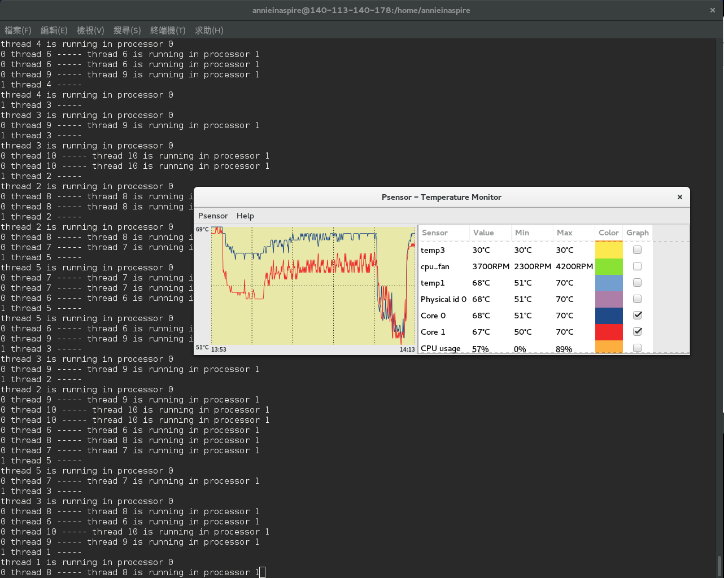
Integration – 1 1 1 1 1 0 0 0 0 0

Slide 24
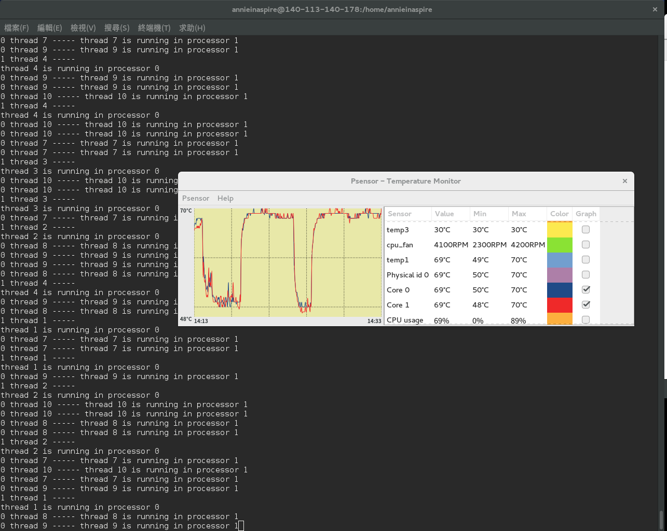
Integration – 1 1 1 1 0 1 0 0 0 0

Slide 25
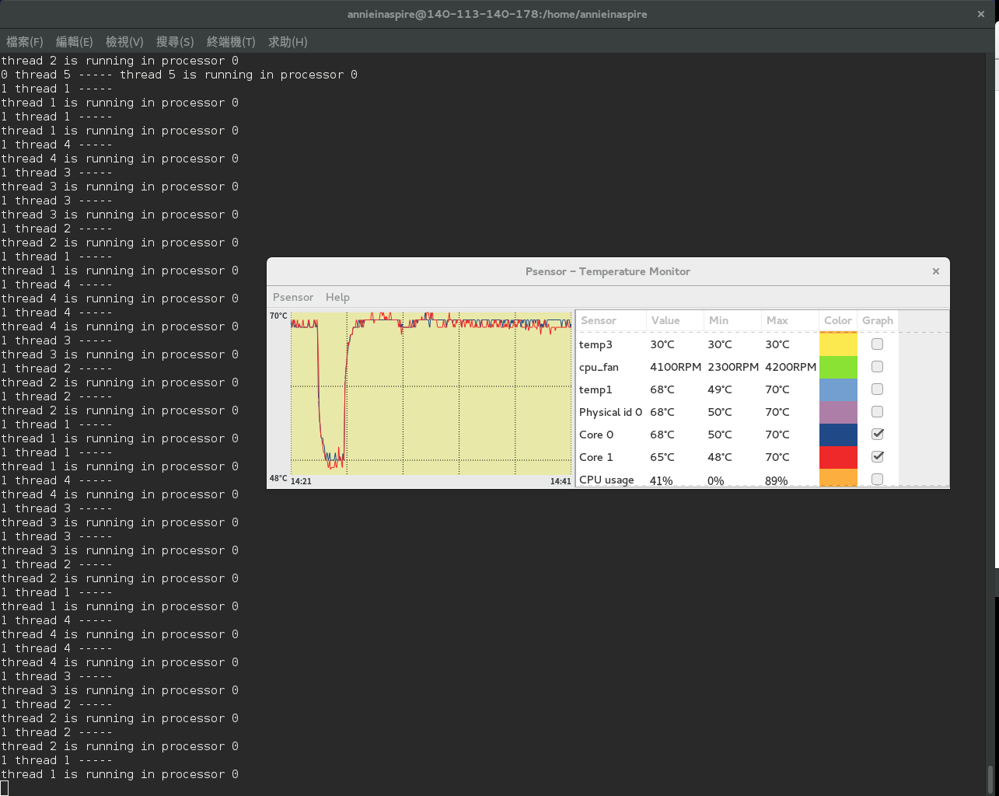
Integration – 1 1 1 1 0 1 0 0 0 0

Slide 26
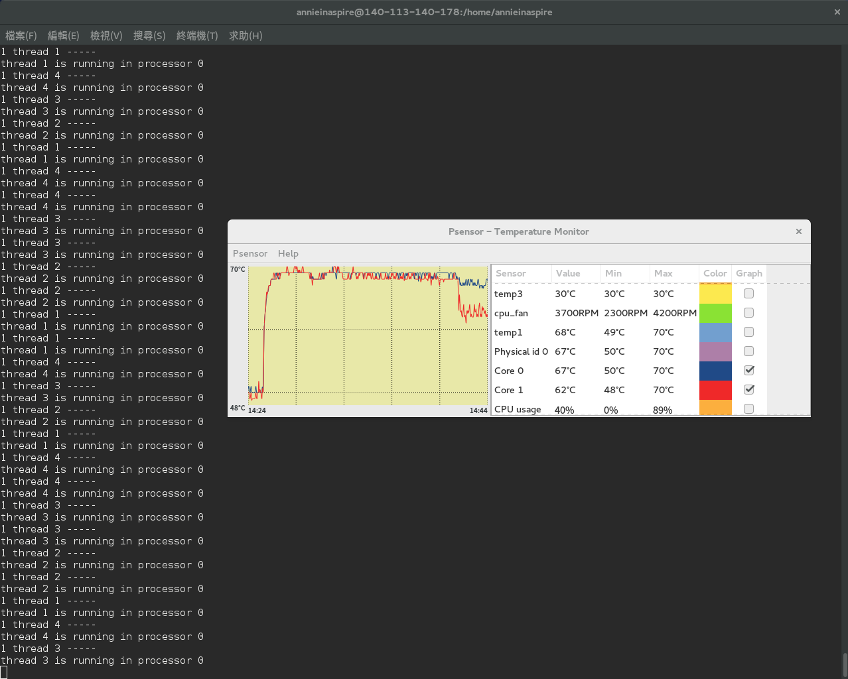
Integration – 1 1 1 1 0 1 0 0 0 0

Slide 27
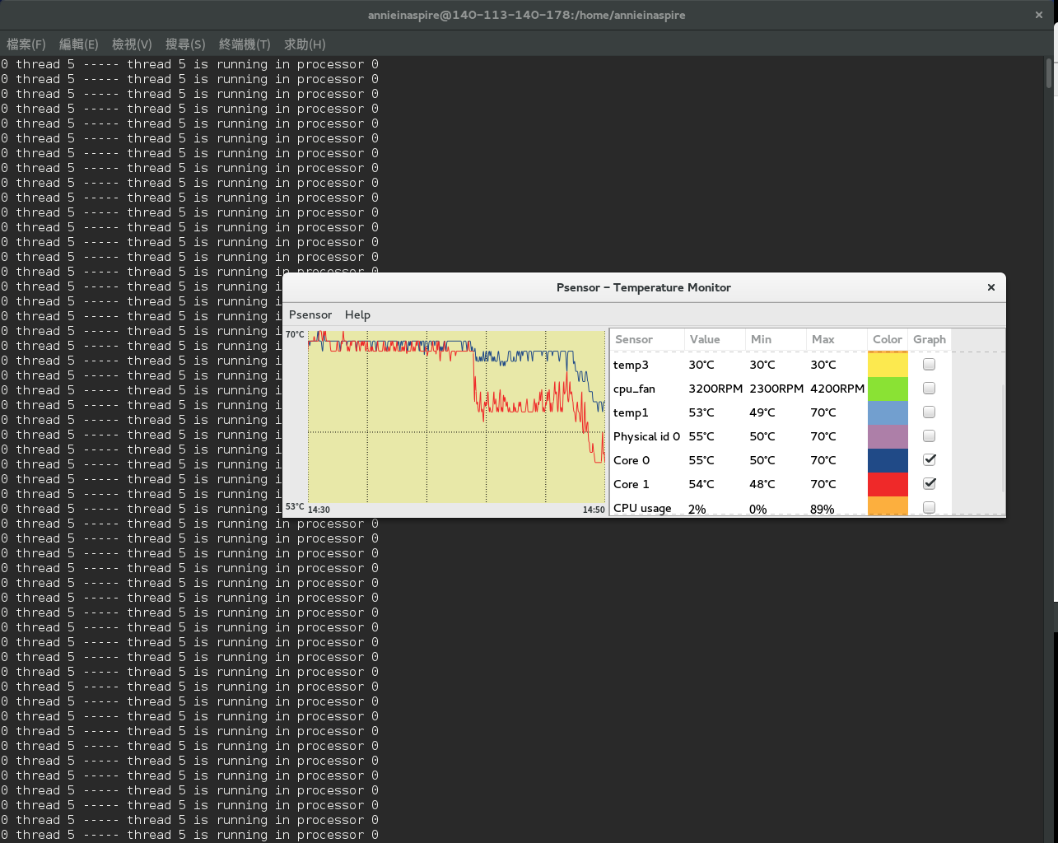
Integration – 1 1 1 1 0 1 0 0 0 0

Slide 28
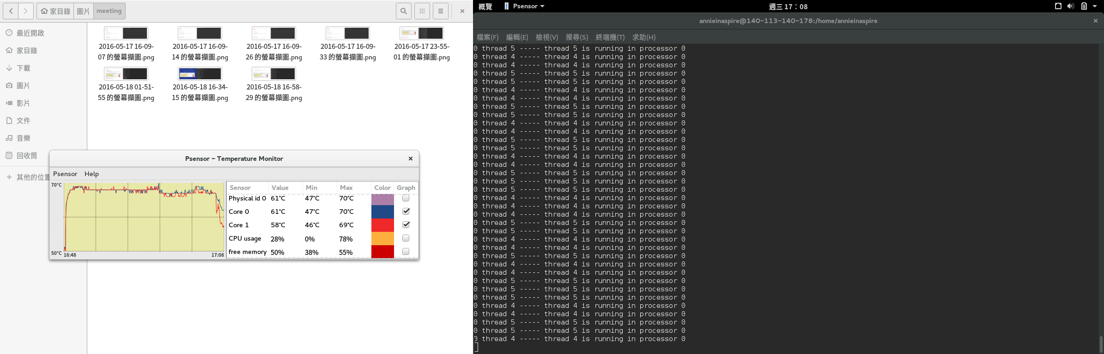
Integration – 1 1 1 0 0 0 0 0 1 1

Slide 29
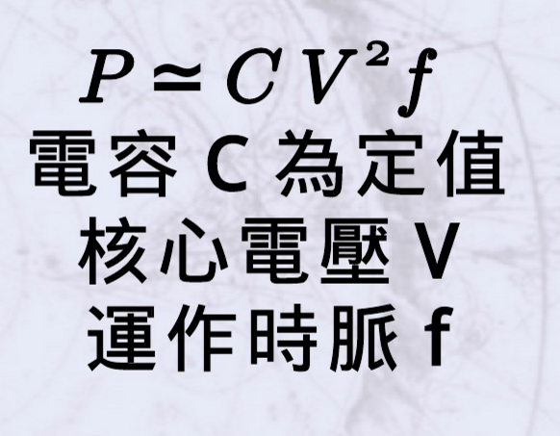

POwertop
PowerTOP是個分析、監控電力消秏的節能工具程式，它是由 Intel 於 2007 以 GPLv2 授權釋出的開放原始碼專案。我們可以使用它找出 GNU/Linux 上秏電的套件，並透過停用不必要的功能以達到省電的效果，是筆記型電腦 (Laptop) 必裝的實用工具。
參考http://www.slideshare.net/yuanchao/introduce-powertop-to-end-users(相關背景知識及使用方法)

Slide 30
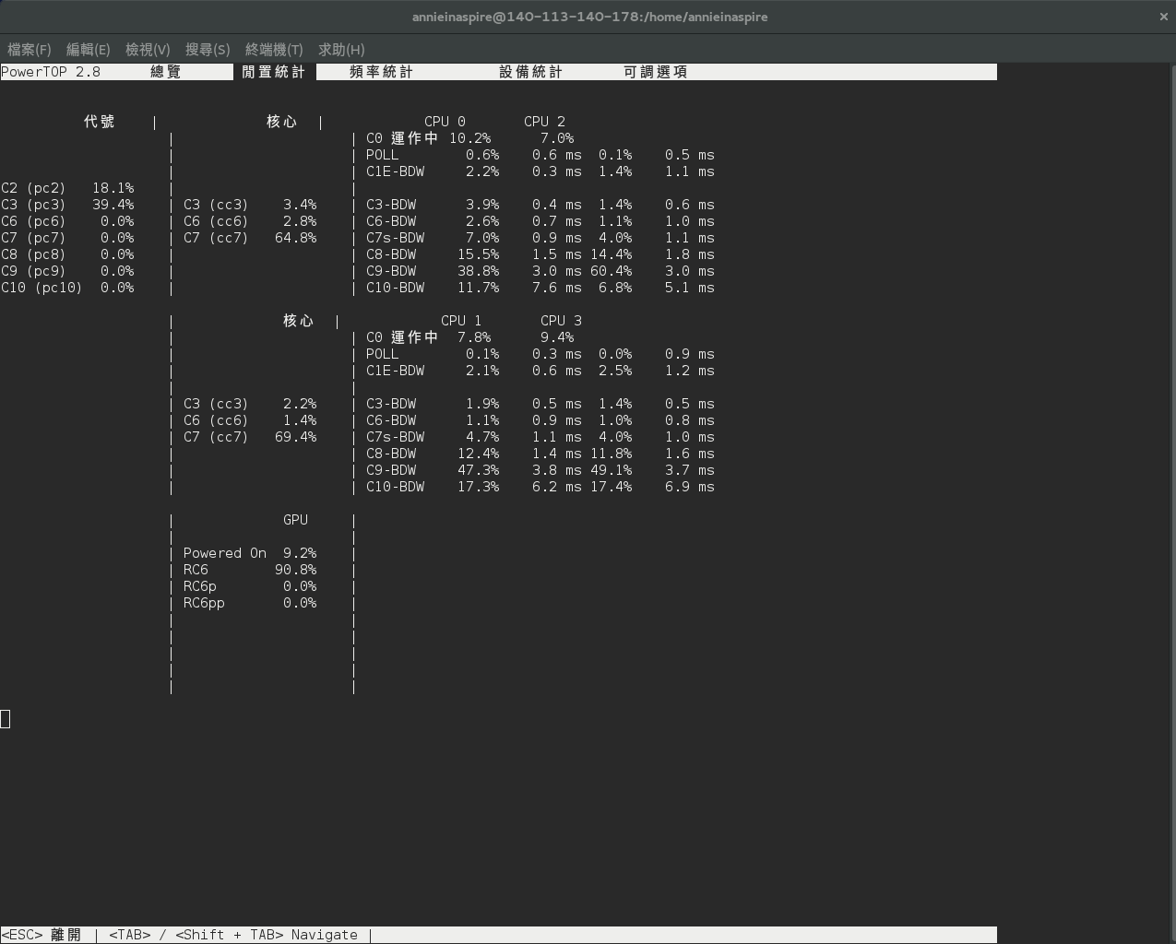

Slide 31
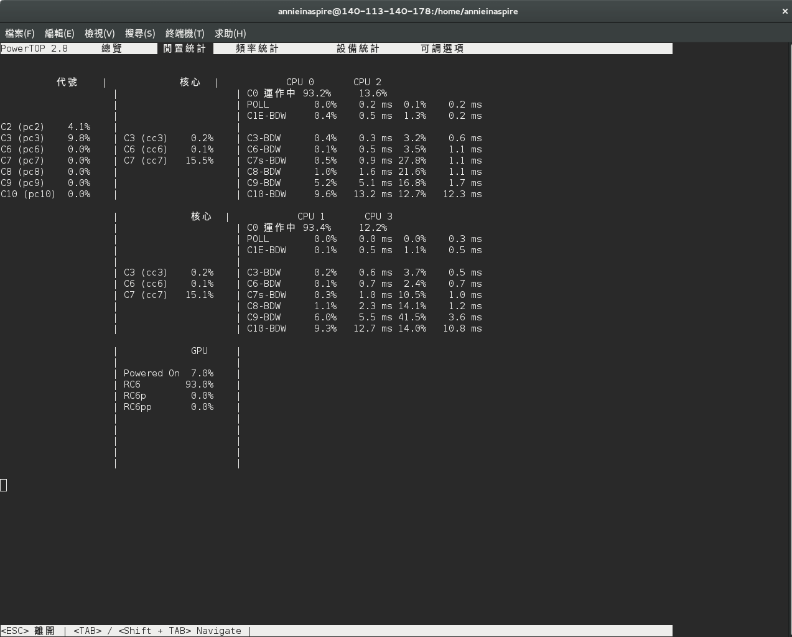

Slide 32
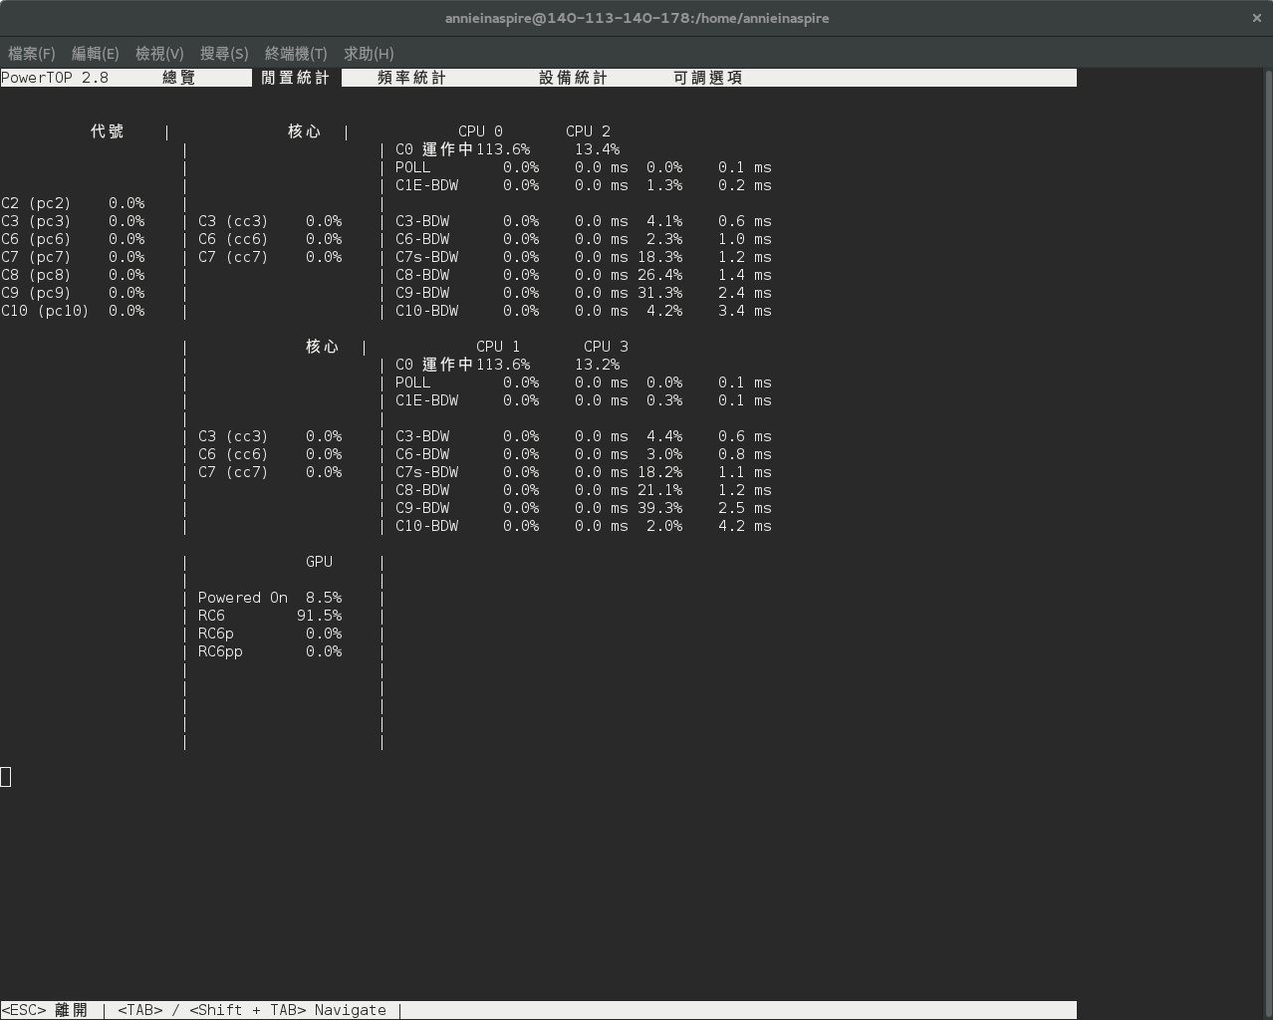

Slide 33
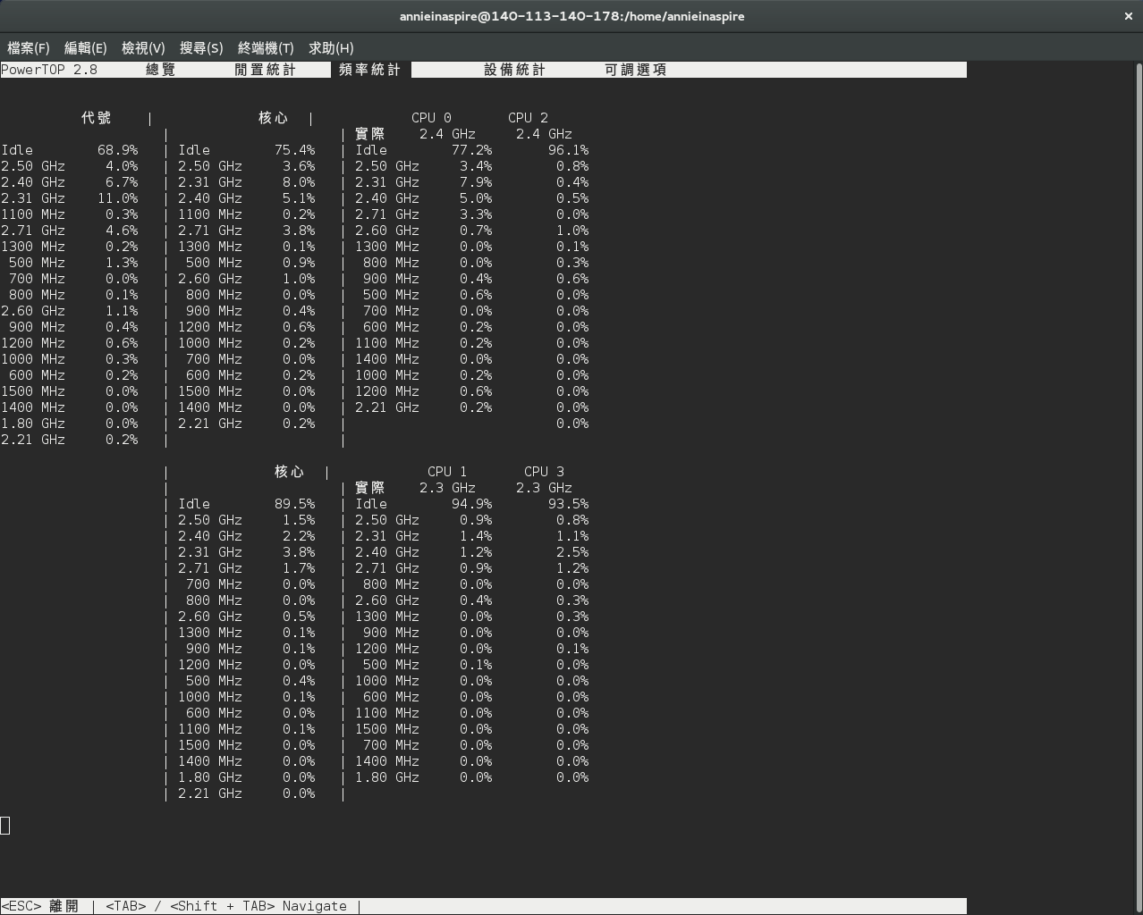

Slide 34
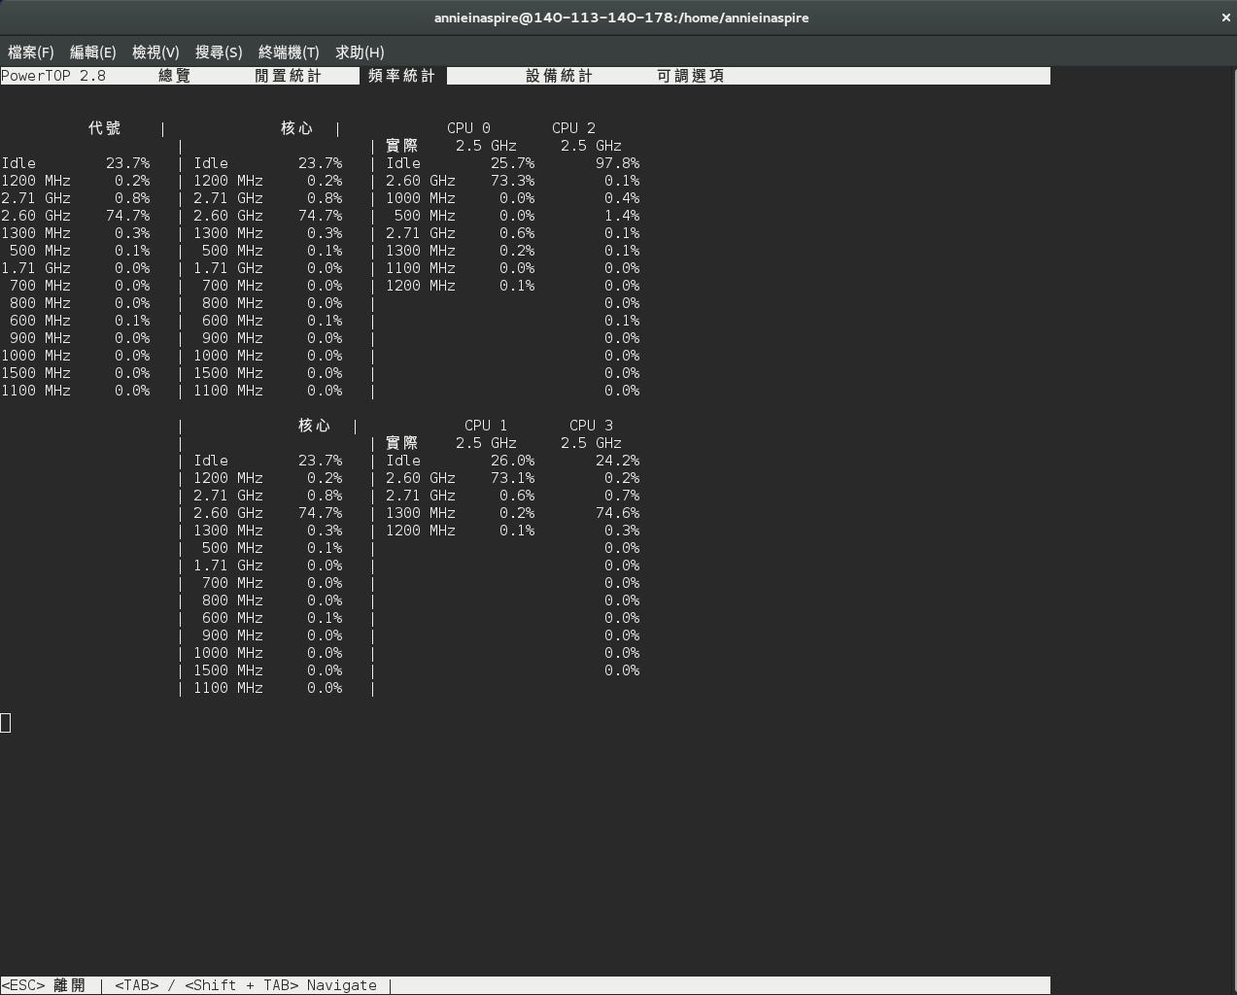

Slide 35
參考資料
設定NICE值：
http://stackoverflow.com/questions/902539/nice-level-for-pthreads
http://stackoverflow.com/questions/7684404/is-nice-used-to-change-the-thread-priority-or-the-process-priority
設定scheduler_policy和priority：
https://www.ualberta.ca/dept/chemeng/AIX-43/share/man/info/C/a_doc_lib/aixprggd/genprogc/threads_sched.htm
http://fcamel-life.blogspot.tw/2012/02/linux-process-priorities-and-scheduling.html
http://blog.csdn.net/maximuszhou/article/details/42042161
https://www.cs.cf.ac.uk/Dave/C/node30.html
http://fanli7.net/a/bianchengyuyan/C__/20130104/284175.html
設定CPU_SET和affinity：
http://www.cnblogs.com/vanishfan/archive/2012/11/16/2773325.html
http://stackoverflow.com/questions/1407786/how-to-set-cpu-affinity-of-a-particular-pthread
powertop：
http://www.slideshare.net/yuanchao/introduce-powertop-to-end-users
boot menu：
sudo grub2-mkconfig -o /boot/efi/EFI/fedora/grub.cfg

